Slide 1

PROJECT ON SORTING VISUALIZER
DONE BY:-SURYADEEP SEN
SARBANANDA MAJI.
CSE,3RD YEAR.
ASANSOL ENGINEERING COLLEGE.

Slide 2

ABSTRACT Sorting algorithms are used to sort a data structure according to a specific order relationship. Visualizing algorithms can be a great way to understand their functioning.

Slide 3

WHAT IS SORTING?
Sorting refers to ordering of data in an increasing or decreasing fashion according to some linear relationship among the data items.
Sorting can be done on names, numbers and records.
Sorting greatly improves the efficiency of searching.

Slide 4


WHAT IS VISUALIZATION ?
The representation of an object, situation, or set of information as a chart or other image.
Mainly Visualization is our mental image formation of something what generally is going on our mind after listening to something new.
Visualization is the graphical representation of information. Information may be data, process or concepts. The main aim of visualization is to visualize and communicate with the information clearly and effectively.

Slide 5
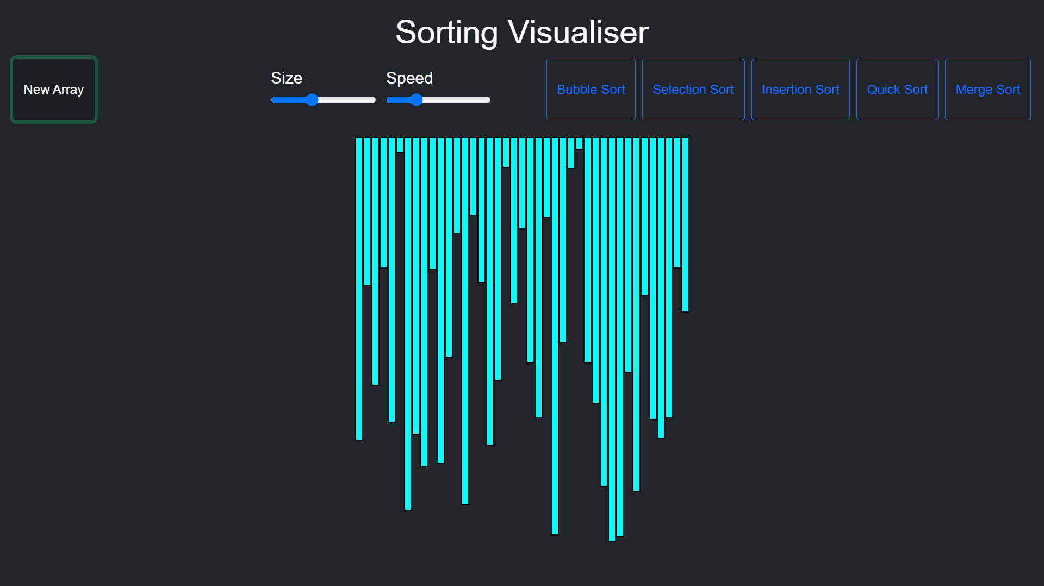
About the project :-
IN THIS SORTING VISUALIZER WE HAVE IMPLEMENTED FEW OF THE SORTING TECHNIQUES LIKE
BUBBLE SORT
SELECTION SORT
INSERTION SORT
QUICK SORT
MERGE SORT

Slide 6




MATERIALS LANGUAGE USED:-
SO TO BUILD OUR SORTING VISUALIZER WE HAVE USED
HTML
CSS
JAVASCRIPT
AND SOME OTHER BASIC WEB DEVELOPMENT TOOLS.
BOOTSTRAP

Slide 7
DIFFERENT SORTING TECHNIQUES USED :-
BUBBLE SORT :-
Bubble Sort is the simplest sorting algorithm that works by repeatedly swapping the adjacent elements if they are in wrong order.
Time Complexity :- O(n^2)

Slide 8
SELECTION SORT :-
THE selection sort algorithm sorts an array by repeatedly finding the minimum element from unsorted part and putting it at the beginning.
In every iteration of selection sort, the minimum element from the unsorted sub array is picked and moved to the sorted sub array AT its right position.
Time Complexity :- O(n^2)

Slide 9
INSERTION SORT
Insertion sort is a simple sorting algorithm that works similar to the way you sort playing cards in your hands.
The array is virtually split into a sorted and an unsorted part.
Values from the unsorted part are picked and placed at the correct position in the sorted part.
Time Complexity :- O(N^2)

Slide 10
QUICK SORT
Quick Sort is a Divide and Conquer algorithm. It picks an element as pivot and partitions the given array around the picked pivot. There are many different versions of quick Sort that pick pivot in different ways.
Always pick first element as pivot.
Always pick last element as pivot (implemented below)
Pick a random element as pivot.
Pick median as pivot.
Time Complexity :- O(N*log(N))

Slide 11
MERGE SORT
Merge sort is one of the most efficient sorting algorithms.
It works on the principle of Divide and Conquer algorithm.
It divides the input array into two halves, calls itself for the two halves, and then merges the two sorted halves.
Time Complexity :- O(Nlog(N))

Slide 12
PROJECT DESCRIPTION :-
TO IMPLEMENT THIS SORTING ALGORITHMS WE HAVE FOCUS ON THE PARTS WHERE ACTUAL SWAPPING AND OTHER KEY FUNCTIONALITIES ARE BEING DONE SO THAT WE CAN VISUALIZE THEM PROPERLY.
WE HAVE ALSO GIVEN THE FUNCTIONALITY TO CHANGE THE SPEED OF THE ALGORITHMS ACCORDING TO US.
WE CAN CHANGE THE SPEED IN BETWEEN THE SORTING SO THAT WE CAN VISUALIZE IT AND UNDERSTAND IT BETTER.
MOREOVER WE CAN ALSO GENERATE NEW ARRAYS BY USING THE NEW ARRAY BUTTON.
WHEN WE START TO VISUALIZE ONE SORTING ALGORITHM THE OTHER buttons like size slider & other sorting OPtions ARE DISABLED.

Slide 13
PROJECT USAGE :-
It is a basic DSA sorting project where we can visualize different sorting techniques and the basic working of these sorting algorithms.
Visualization can motivate the student to learn and understand easily.
I am planning to bring more algorithms in action to visualize and make necessary changes.

Slide 14
CONCLUSION :-
Sorting algorithm can be difficult to understand and it’s easy to be confused.
We believe visualizing sorting algorithms can be a great way for better understanding their functions while having fun!.

Slide 15
THANK YOU

